Slide 1
Divide and Conquer Algorithms
By: Brandon Shippy

Slide 2
What is a “Divide and Conquer Algorithm”?
An algorithm that “divides” up the work into smaller pieces, only running necessary parts for the specific task.
It allows us to take a larger task and only do a part of it, instead of wasting time running the entire function.
It specifically divides the problems recursively into smaller problems until it is “conquered”.
Once it is conquered the entire problem is typically remerged, specifically with certain types of sorts.

Slide 3
Use Case: Merge Sort
This algorithm is used when you want to take an array of values and sort them, by a specific property. Typically used in an array of ints, doubles, etc.
The beauty in this algorithm is that is will actually split the array in half and work on each half individually.
Once each half is conquered it then merges the two halves back into a single array, which is now sorted.

Slide 4
Visual Representation of Merge Sort
Images Courtesy of geeksforgeeks.com (sources at end)

Slide 5
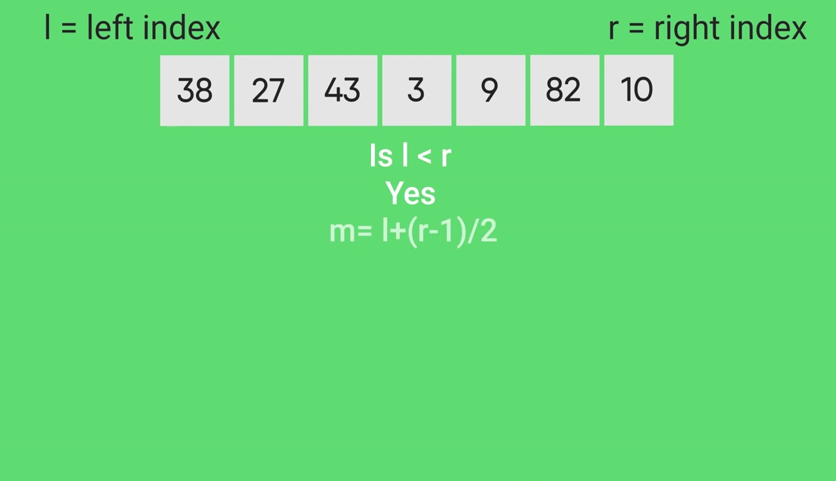

Slide 6
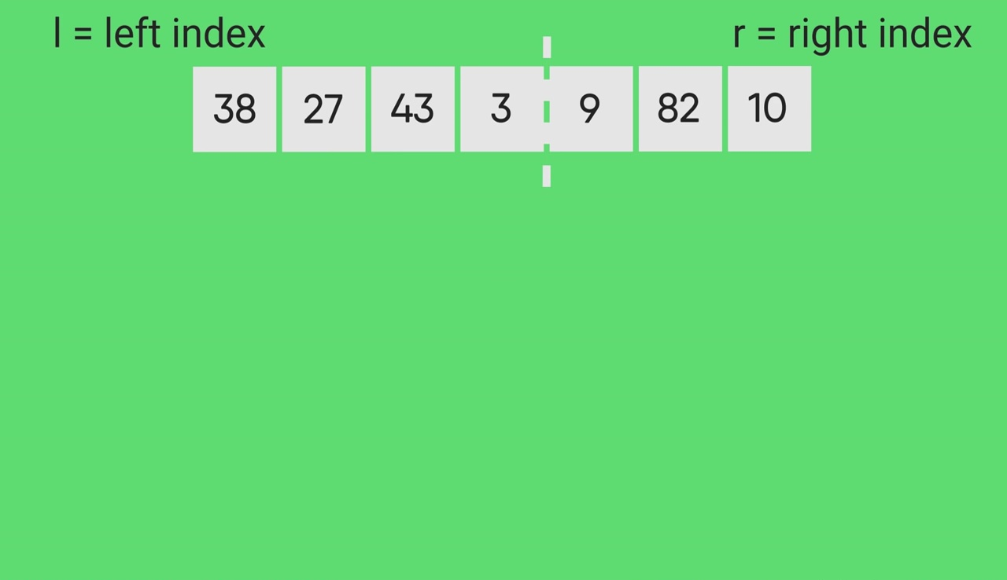

Slide 7
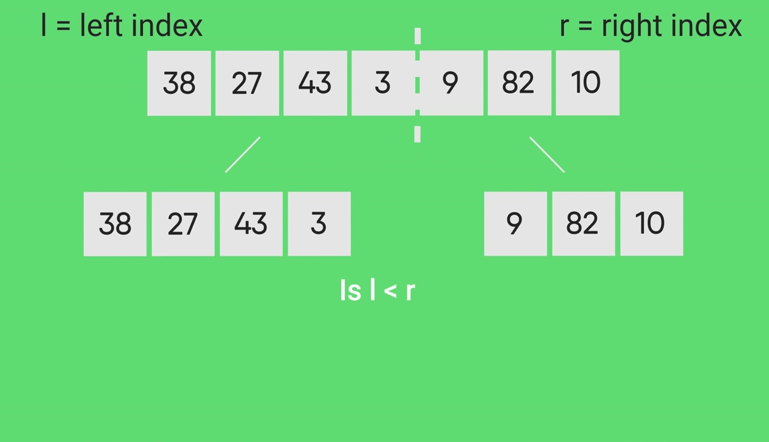

Slide 8
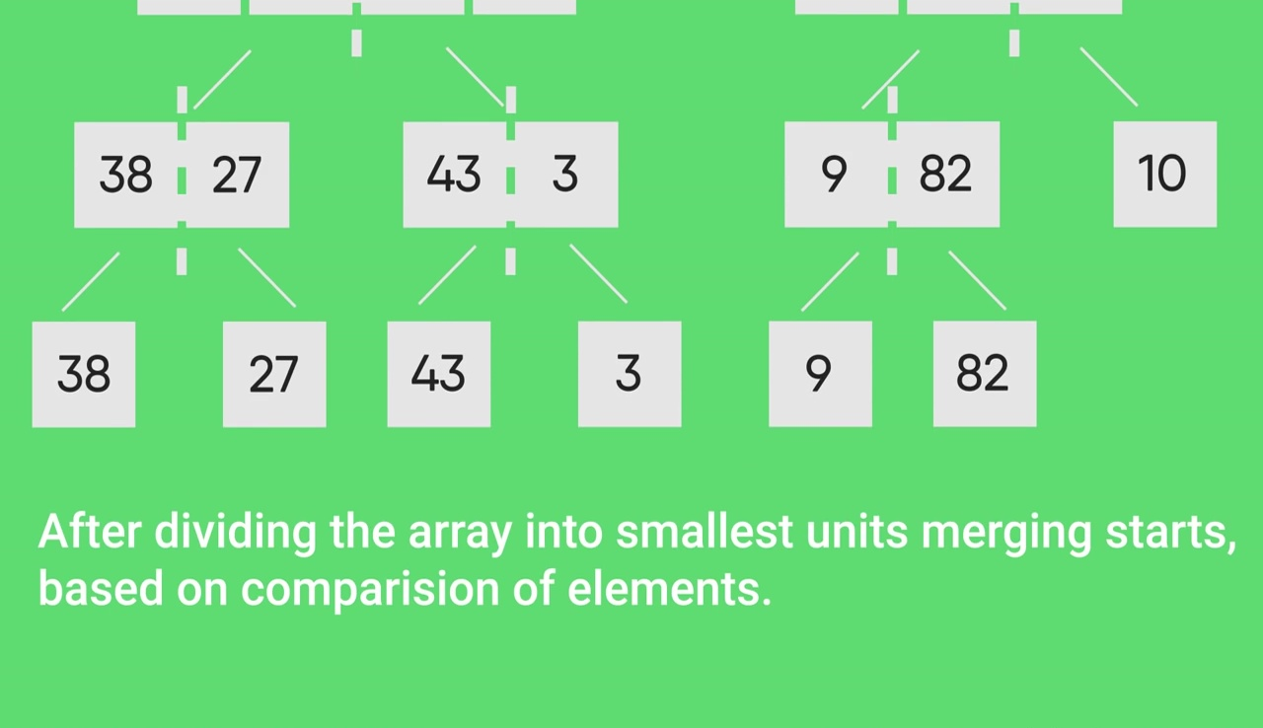

Slide 9
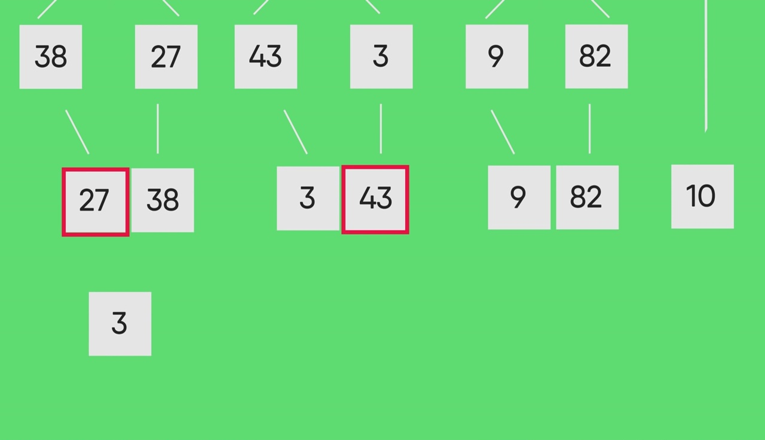

Slide 10
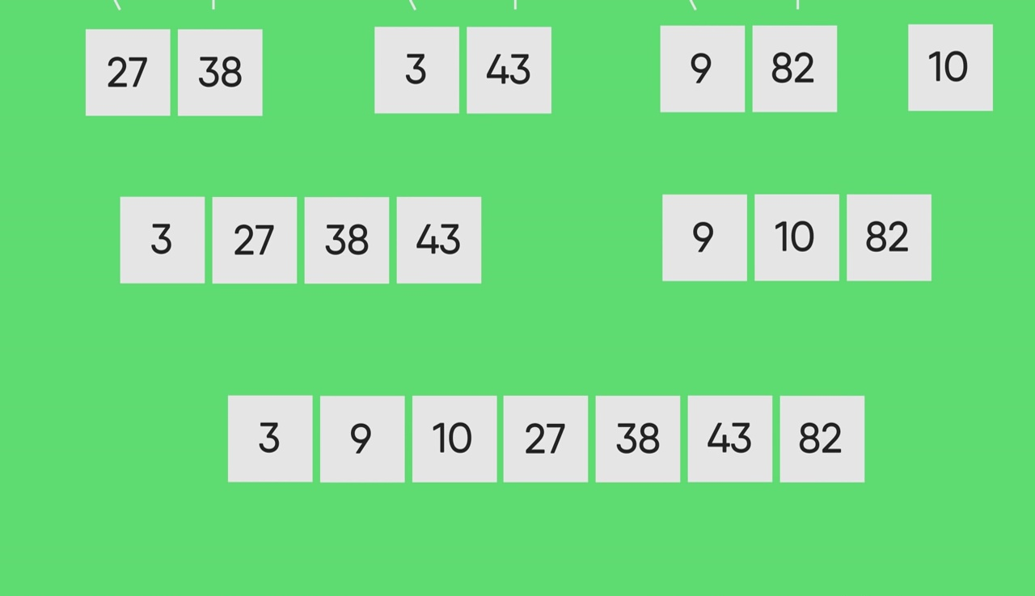

Slide 11
A more advanced Use Case: Closest Pair of Points
This algorithm is used to find the smallest amount of distance between two points on a plane.
Each point on the plane is held in an array of which is sorted based on location on plane. Typically from left to right.
This algorithm splits the plane up into smaller sections, this is so we can only look at the points that matter to our point we are comparing with.
It eventually merges all the results together and spits out the smallest distance.

Slide 12
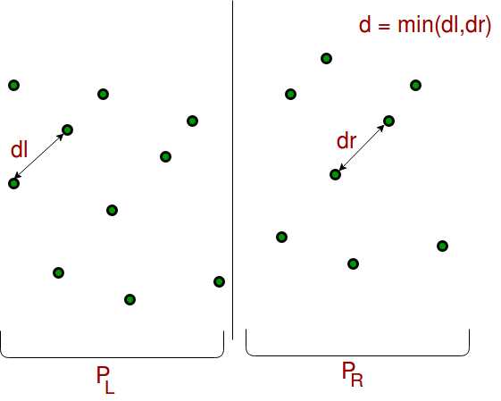

Slide 13
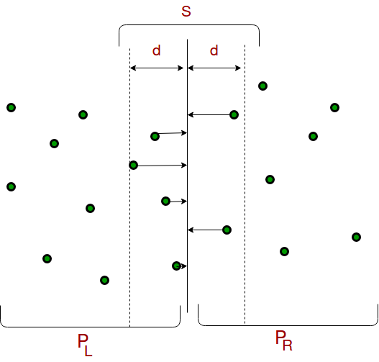

Slide 14
Sources
https://www.geeksforgeeks.org/divide-and-conquer-algorithm-introduction/ https://www.geeksforgeeks.org/closest-pair-of-points-using-divide-and-conquer-algorithm/ https://www.geeksforgeeks.org/merge-sort/

